Slide 1
Homeland Security Starts with Hometown Security
Resilient Utilities Coalition
23 May 2018

Slide 2
Matthew Frost
Protective Security Advisor
Matthew.Frost@HQ.DHS.gov

Slide 3
Homeland Security Starts with Hometown Security
The U.S. Department of Homeland Security (DHS) closely monitors attacks on public gatherings and public places to constantly enhance the Nation’s security. During both steady state and times of heightened awareness, DHS engages closely with our private sector and community partners to provide expert counsel and recommendations about protective measures they can implement to protect facilities and venues. DHS provides free tools and resources to communities because the Department recognizes that communities are the first line of defense in keeping the public safe and secure.
The Department encourages businesses to Connect, Plan, Train, and Report. Applying these four steps in advance of an incident or attack can help better prepare businesses and their employees to proactively think about the role they play in the safety and security of their businesses and communities.

Slide 4
Homeland Security Starts with Hometown Security
Connect:
Reach out and develop relationships in your community, including local law enforcement. Having these relationships established before an incident occurs can help speed up the response when something happens.
Notes:
•Develop relationships with local law enforcement and businesses in your area. Invite local lawenforcement to tour your business.
•Connect with community security and preparedness organizations such as the Federal Bureau ofInvestigation’s public-private partnership program “InfraGard.”
•Contact the local DHS Protective Security Advisor who is available to support your efforts.
•Communicate with your customers and let them know about the security measures you are taking toensure a positive experience and to maintain public safety.
•If your business is located at or near a Federal facility, connect with DHS’s Federal Protective Service at1-877-4FPS-411.

Slide 5
Homeland Security Starts with Hometown Security
Plan:
Take the time now to plan on how you will handle a security event should one occur. Learn from other events to inform your plans.
Notes:
Be aware of current threats related to your geographic region or impacting your business sector.
•Develop plans, including security, emergency response, emergency communications, and business continuity plans, while considering the protection of your employees and customers, access control, closed-circuit television, signage, suspicious activity reporting, and parking security.
•Evaluate your security requirements and design a monitoring, surveillance, and inspection program that is consistent with your business operations.
•Develop evacuation and shelter-in-place plans, and ensure that multiple evacuation routes are clearly marked with appropriate signage and that rallying points are available.
•Develop and implement a security plan for computer and information systems hardware and software.
•Engage local first responders (police, fire, medical) in all of the above efforts to ensure your efforts are in synergy with theirs.

Slide 6
Homeland Security Starts with Hometown Security
Train:
Provide your employees with training resources and exercise your plans often. The best laid plans must be exercised in order to be effective.
Notes:
•Train employees on identifying and reporting suspicious activities, active shooter scenarios, and what todo if they suspect an improvised explosive device (IED). Ensure they understand security basics,emergency response, business continuity plans, and increased awareness of potential threats.
•Exercise your emergency communications plan.

Slide 7
Homeland Security Starts with Hometown Security
Report:
“If You See Something, Say Something™” is more than just a slogan. Call local law enforcement.
Notes:
•Post details on reporting suspicious activity and encourage employees, tenants, and visitors to reportsuspicious behavior to property management security or local law enforcement. Things to considerinclude unattended vehicles; repeat visitors or outsiders who have no apparent business in non-publicarea; abandoned parcels, suitcases, backpacks, and packages; and other unusual activity.
•Get involved with the Department’s “If You See Something, Say Something™” campaign.

Slide 8
Homeland Security Starts with Hometown Security
DHS Programs, Resources, and Tools You Can Use
Protective Security Advisors proactively engage with government partners and the private sector to protect critical infrastructure. For more information or to contact your local PSA, e-mail NICC@hq.dhs.gov.
The Ready Campaign provides help with planning for businesses at http://www.ready.gov/business.
DHS Active Shooter resources are available at http://www.dhs.gov/active-shooter-preparedness.
“If You See Something, Say Something™” http://www.dhs.gov/see-something-say-something.
Nationwide Suspicious Activity Reporting (SAR) Initiative (NSI) information is available at https://nsi.ncirc.gov/. SAR training for private sector partners is located at https://nsi.ncirc.gov/hsptregistration/private_sector/.
Counter-Improvised Explosive Device information and resources are available at www.dhs.gov/tripwire.
Information on DHS cybersecurity programs is available at www.dhs.gov/cyber. To find out more about the Cybersecurity Awareness Campaign, go to http://www.dhs.gov/stopthinkconnect. For tips from the U.S. Computer Emergency Response Team, go to https://www.us-cert.gov/ncas/tips.
InfraGard is a public-private partnership between the FBI and the private sector that represents individuals from businesses, academic institutions, State and local law enforcement, and fire and EMS agencies, as well as other participants dedicated to sharing information, education, and intelligence. Please go to www.infragardmembers.org and https://www.infragard.org.

Slide 9
Protective Security Advisors 101
In support of this Mission and to provide a closer partnership with State governments, local communities, and businesses, the Department of Homeland Security (DHS) has placed a national presence, Protective Security Advisors (PSAs), in local communities throughout the country to assist with local efforts to protect critical assets. As individuals averaging 20 years of law enforcement, military, and anti-terrorism experience, PSAs are recruited from, live, and work in local communities. PSAs provide a Federal resource to communities and businesses to assist in the protection of our Nation’s critical infrastructure and key resources (CIKR) and further State and local homeland security initiatives.
As a result of their location throughout the United States, PSAs are often the first DHS personnel to respond to incidents. Consequently, PSAs are uniquely able to provide early situational awareness to DHS and Office of Infrastructure Protection (IP) leadership during an incident, often performing duties as the Infrastructure Liaison (IL) at the Joint Field Office (JFO) in support of the Principal Federal Official (PFO).

Slide 10
Protective Security Advisors 101
PSA Mission Areas:
Provide guidance on established security practices
Conduct Security Surveys, Gap Analysis, and Assessments
Conduct Outreach Activities
Support National Special Security Events (NSSEs) and Special Event Activity Rating (SEAR) Events
Respond to Incidents
Provide Improvised Explosive Devise (IED) Awareness & Risk Mitigation Training
Support the development of the national risk picture by identifying, assessing, monitoring and minimizing risk to critical assets at the local level
Serve as advisors regarding infrastructure during activation of the National Response Framework

Slide 11
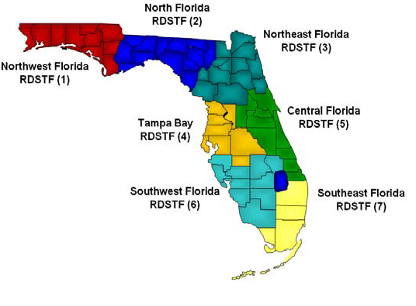
PSA Areas of Responsibility
REGION | 1 2 3 | PSA | Billy Sasser
 | 4 | PSA | Ollie Gagnon
 | 5 | PSA | Marty Smith
 | 6 7 | PSA’s | Gary Warren Matt Frost

Slide 12
Protected Critical Infrastructure Information (PCII)
Congress created the Protected Critical Infrastructure Information (PCII) Program under the Critical Infrastructure Information (CII) Act of 2002 to protect private sector infrastructure information voluntarily shared with the government for the purposes of homeland security.
The protections offered by the PCII Program enhance the voluntary sharing of critical infrastructure information between infrastructure owners and operators and the government by giving homeland security partners confidence that sharing their information with the government will not expose sensitive or proprietary data.h

Slide 13
Infrastructure Survey Tool
The Infrastructure Survey Tool (IST) is a voluntary, web-based security survey conducted by Protective Security Advisors (PSAs) in coordination with facility owners and operators after an Site Assistance Visit to identify and document the overall security and resilience of the facility. The security survey is conducted to:
Identify facilities’ physical security, security forces, security management, information sharing, protective measures, and dependencies related to preparedness, mitigation, response, resilience, and recovery.
Identify security gaps.
Create facility protective and resilience measures indices that can be compared to similar facilities.
Track progress toward improving critical infrastructure security.

Slide 14
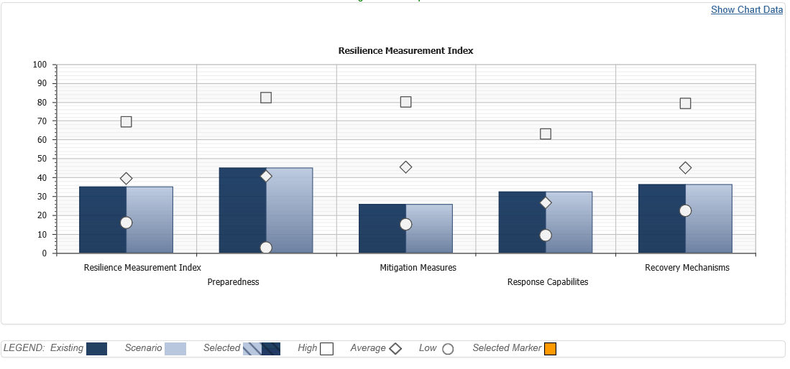
Resilience Management Dashboard

Slide 15
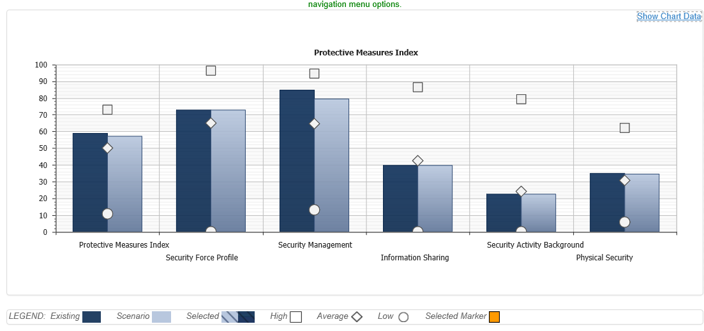
Protective Measures Dashboard

Slide 16
DHS Cyber Security Evaluations/Tools
Cyber Hygiene (CH) Evaluations –(NCATS)
Penetration Test (RVA)
Cyber Resilience Review (CRR)
Cyber Infrastructure Tool (CYBER-IST)
Cyber Security Evaluation Tool (CSET)

Slide 17
Matthew Frost
Protective Security Advisor
Matthew.Frost@HQ.DHS.Gov

